Slide 4
A

Slide 5
A
A
A

Slide 6
A
h?
A
A

Slide 7
A
A
x
½ A
H = 2*X?
A
A

Slide 8
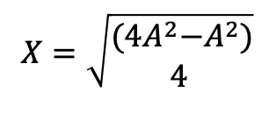
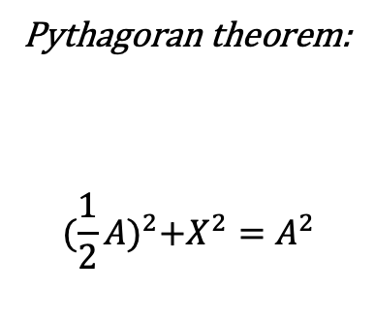
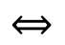
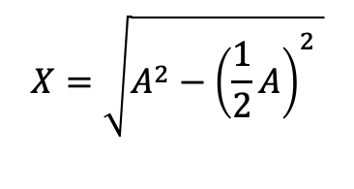
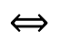
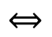
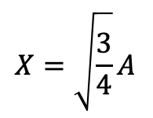
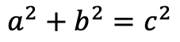
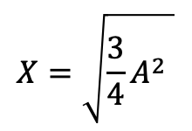
Pythagoran theorem:
$${(\frac{1}{2}A)}^{2}+X^{2}=A^{2}$$
$$a^{2}+b^{2}=c^{2}$$
A
x
$$X=\sqrt{A^{2}−{\left(\frac{1}{2}A\right)}_{ }^{2} }$$
$$⟺$$
½ A
$$X=\sqrt{\begin{aligned}{(4A}^{2}−A_{\begin{aligned} \\ \end{aligned}}^{2}) \\ 4 \end{aligned}}$$
$$⟺$$
$$X=\sqrt{\frac{3}{4}A^{2} }$$
$$⟺$$
$$X=\sqrt{\frac{3}{4}}A$$
$$⟺$$
X ~ 0,866025403784439A

Slide 9

x
A
A
Long diameter: 2 * A
x
Short diameter: 2 * X $≈$ 1,732050807568877 * A

Slide 10

0,0
25,0
75,0
100,0
x
A
A
0,43.3
100,43.3
x
0, 86.6
100, 86.6
25, 86.6
75, 86.6
Short diameter: 2 * X $≈$ 1,732050807568877 * A

Slide 11
(X, Y) = (0A, 0A)

Slide 12
(X, Y) = (0A, 0A)
(X, Y) = (1.5A + gap, 0.866A + gap)

Slide 13
(X, Y) = (0A, 0A)
(X, Y) = (3A+2*gap, 0A)
(X, Y) = (1.5A + gap, 0.866A + gap)
(X, Y) = (0A, 1.732A + gap)
(X, Y) = (3A+2*gap, 1.732A + gap)
(X, Y) = (1.5A + gap, 3*0.866A + 2*gap)

